Slide 1
Identifying Bug Types & Severity in Open-Source Code
Mid Semester Progress Report
Group Members:
Ishir Bhardwaj (2022223)
Manit Kaushik (2022277)
Pranav Gupta (2022364)
Raghav Wadhwa (2022385)
Link to Progress Report

Slide 2
Motivation
As engineering students, we frequently work on software projects where managing bugs is a crucial part of the development cycle. Manually categorizing bugs by severity and type can be time-consuming and prone to error, especially in large-scale projects. This project aims to automate the process using machine learning, improving the efficiency of bug triage, reducing manual intervention, and ensuring timely resolution of critical issues. The idea originated from the recurring need for faster bug handling in software development workflows.

Slide 3
Literature Review
Our project focuses on two key aspects: identifying the type of bug and predicting its severity, encompassing both classification and regression tasks. For our literature review, we examined papers that addressed these two problems individually.

Slide 4
Paper I:Predicting Bug Type
Name: Not all bugs are the same: Understanding, characterizing, and classifying bug types (March 2019)
Goal: To build a taxonomy of reported bug types and develop an automated classification model to classify bugs based on this taxonomy.
Dataset: Manually classifying 1280 bug reports of 119 software projects belonging to ecosystems such as Mozilla,Apache, and Eclipse.
Features: Extracted textual descriptions from bug reports, including details such as error messages, file names, and system components. Then TF-IDF was used to identify relevant terms
Method: Logistic Regression classifier with TF-IDF features derived from bug report summaries
Result: Identified 9 bug types; model achieved 64% F-Measure and 74% AUC-ROC​

Slide 5
Paper II: Predicting Severity Level
Name: Machine Learning Approaches for Predicting the Severity Level of Software BugReports in Closed Source Projects (Jan 2019)
Goal: build prediction models that will be utilized to determine the class of the severity (severe or non-severe) of the reported bug
Dataset: Bug reports extracted from JIRA bug tracking system used by INTIX company, they have a bug ID & a short description
Features: bug report is transformed into a feature of vector (Bag-of-Words) using Tokenization, Stop-words removal & Stemming
Method: Naive Bayes, Naive Bayes Multinomial,Support Vector Machine (SVM), Decision Tree (J48), RandomForest, Logistic Model Trees (LMT), Decision Rules (JRip)and KNN.
Result: LMT algorithms reported the best performance results based on all performance measures (Accuracy= 86.31, AUC= 0.90,F-measure= 0.91).

Slide 6
Dataset Description
Our project delves into the problem of identifying the type of bug and the severity of the bug reported. For our project, we have targeted datasets which contain bug reports of different open-source projects, softwares and bug-reporting systems for example Eclipse, JIRA, Google Chromium, Mozilla Core, and Mozilla Firefox. These bug reports contain the descriptions of the bug reported, their severity/priority level, bug status, bug types and other details of the bug reported.
Reference Links:
https://github.com/ansymo/msr2013-bug_dataset
https://www.kaggle.com/datasets/antonyjr/jira-issue-reports-v1
https://www.kaggle.com/datasets/samanthakumara/software-bug-reports
https://www.kaggle.com/datasets/crawford/deeptriage/data

Slide 7
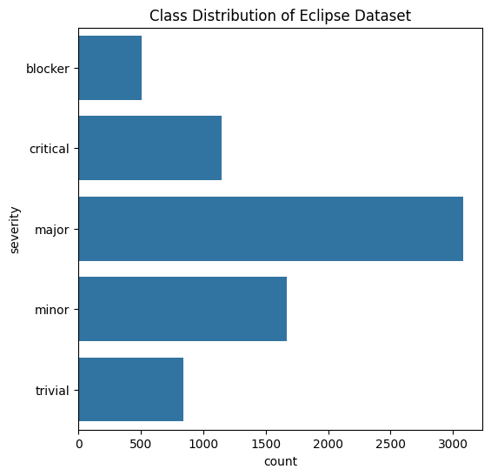
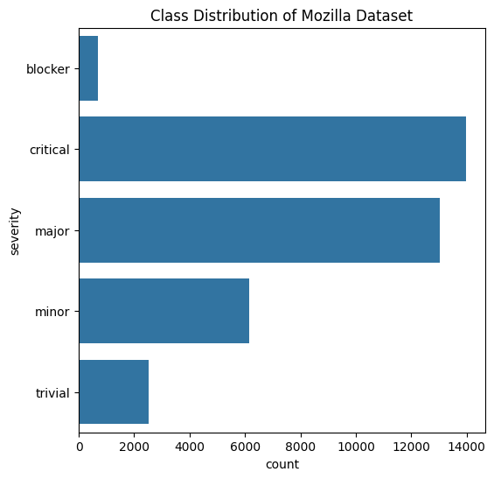
Dataset for Predicting Bugs Severity
The bug reports from Eclipse & Mozilla include a ‘severity’ field, which will be used as the target classes for testing in this part of our project. Below is a summary of the datasets:
Open-Source Software Projects | Number of Bug Reports | Number of Bug Severity Classes | Bug Severity Classes
Mozilla | 45461 | 5 | 'critical', 'blocker', 'trivial', 'minor', 'major'
Eclipse | 9664 | 5 | 'Minor','Trivial', 'Critical', 'Major', 'Blocker'

Slide 8
Dataset for Supervised Bugs Type Prediction
For the task of predicting bug types, we collected issue reports generated by the JIRA bug tracking system from various open-source projects. These issue reports contain multiple categories for 'Bug Type.' For our project, we grouped these categories into broader classes and used these as our target labels. The dataset consists of 609,697 records with 18 features.
Combined Class Name | Number of Samples in this class | Subclasses
Defect | 382411 | 'Bug', 'Defect', 'Patch', 'Test', 'Clarification', 'Quality Risk', 'Support Patch', 'Backport', 'TCK Challenge', 'CTS Challenge'
Improvement | 216161 | Improvement', 'New Feature', 'Feature Request', 'Enhancement', 'Wish', 'Component Upgrade', 'Dependency upgrade', 'Remove Feature', 'Library Upgrade', 'Component Upgrade', 'Refactoring', 'Release'
Task | 102343 | 'Task', 'Sub-task', 'Story', 'Documentation', 'Question', 'Brainstorming', 'Technical task', 'Umbrella', 'Suitable Name Search', 'Tracker', 'Epic', 'Requirement', 'New JIRA Project', 'Temp', 'RTC', 'Pruning'

Slide 9
Dataset for Unsupervised Bugs Type Prediction
As a next step, time permitting, we will attempt to predict the bug field (e.g., memory, security, GUI) mentioned in the generated bug reports. Since the exact bug field is not available unless manually classified, we have adopted an unsupervised approach, with labeling applied only to the test portion of the dataset (done by LLM/manually). We have selected the DeepTriage dataset for this purpose, which contains bug reports from Google Chromium, Mozilla Core, & Mozilla Firefox, each including the bug ID, title, and description.

Slide 10
Dataset Preprocessing
NLP preprocessing steps used:
Tokenization: This process involves breaking down text into smaller units, typically words or phrases, known as tokens. Tokenization helps in analyzing each word individually.
Stop Words Removal: Common words such as "the", "and", "is" that occur frequently in the language but add little to no contextual meaning are removed. This helps in reducing noise and focusing the analysis on more meaningful words.
Lemmatization: Words are converted to their base or root form, known as a lemma. For example, words like "running" or "ran" are reduced to "run." This normalization of words ensures that variations of the same word are treated as a single entity.
Eg. “Watching the same user twice produces a SQL error” changes to “Watch user twice produce SQL error”

Slide 11
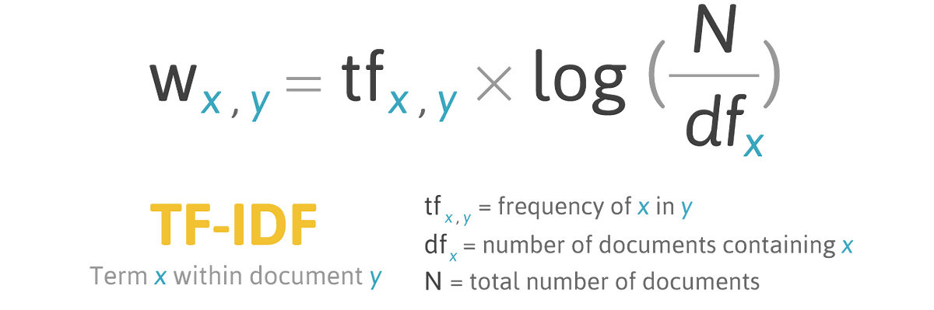
Methodology for Predicting Bugs Severity
After preprocessing the data Named Entity Recognition (NER) is employed to identify key entities such as software names and error codes, enriching the feature representation. Eg for [1.5][compiler] 3.4RC4 java compiler fails to correctly erase generic type information, NER adds [('1.5][compiler', 'CARDINAL'), ('3.4RC4', 'CARDINAL')]
The machine learning pipeline begins with TF-IDF vectorization, incorporating both unigrams and bigrams to capture individual words and meaningful word pairs, enhancing contextual understanding.
Latent Semantic Analysis (LSA) is then applied using Truncated SVD to reduce the feature space to 100 components, minimizing noise and complexity while preserving essential information. These refined feature vectors serve as input for the machine learning models, enabling accurate predictions based on the enriched text.

Slide 12
Results for Predicting Bugs Severity
The created feature set have only been implemented with Multinomial Logistic Regression model, as of right now:
 | Mozilla Dataset |  |  | Eclipse Dataset
Class | Precision | Recall | F1 - Score | Precision | Recall | F1 - Score
blocker | 0.60 | 0.18 | 0.28 | 0.58 | 0.04 | 0.08
critical | 0.78 | 0.72 | 0.75 | 0.35 | 0.14 | 0.20
major | 0.51 | 0.78 | 0.61 | 0.50 | 0.82 | 0.62
minor | 0.45 | 0.20 | 0.27 | 0.50 | 0.36 | 0.42
trivial | 0.45 | 0.09 | 0.15 | 0.50 | 0.30 | 0.39
Accuracy | 0.60 |  |  | 0.49
The overall accuracy for the Eclipse dataset is 0.49, reflecting that the model's performance is average and the overall accuracy for the Mozilla dataset is 0.60, a noticeable improvement over the Eclipse dataset because of more samples. Class imbalance in both datasets directly affects F1-scores. Handling the imbalance marginally improves F1-scores for minority classes but this reduces overall accuracy to 0.49 due to mis-classification of majority classes.

Slide 13
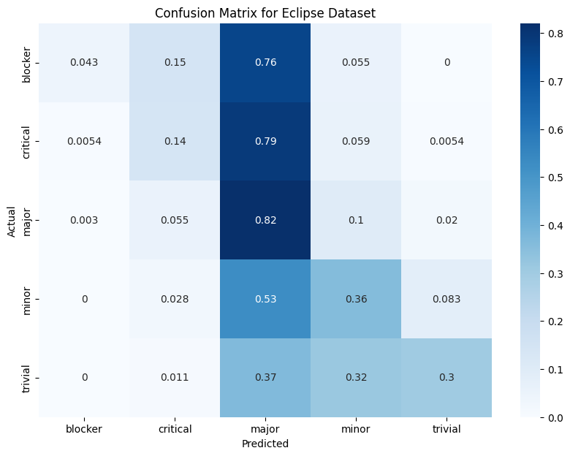
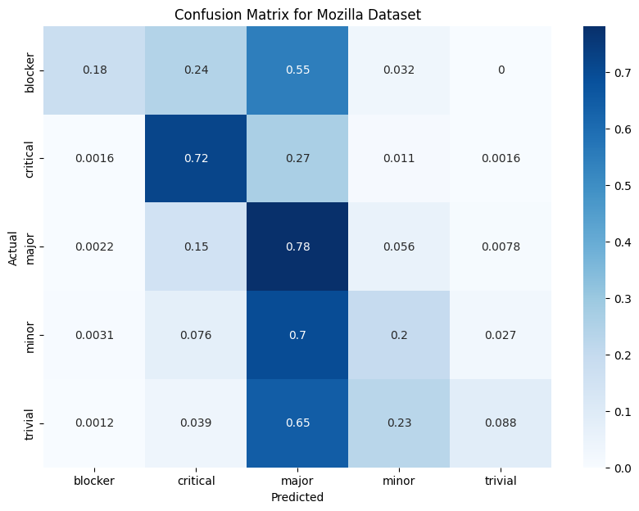
Analysis for Predicting Bugs Severity
A significant issue observed in both datasets is the over-prediction of the major severity class. For instance, 76% of blocker bugs and 79% of critical bugs in the Eclipse dataset are misclassified as major. Similarly, in the Mozilla dataset, 55% of blocker and 27% of critical bugs are classified as major. The minor and trivial classes in both datasets are generally poorly predicted. For example, in the Eclipse dataset, only 36% of minor bugs are correctly classified, while in the Mozilla dataset, only 20% of minor bugs are accurately predicted. Similarly, the recall for trivial bugs remains very low in both datasets.

Slide 14
Methodology for Supervised Bugs Type Prediction
After preprocessing in done, class imbalance is handled because of the wide-ranging sub-classes in the original dataset, class weights are calculated and applied to ensure balanced learning. The machine learning pipeline incorporates TF-IDF (Term Frequency-Inverse Document Frequency) vectorization, where both unigrams and bigrams are used to capture single words as well as pairs of words, adding contextual richness. Following this, feature selection is performed using the chi-squared (chi2) statistic to retain the most informative features, reducing the feature space to 2000 dimensions.

Slide 15
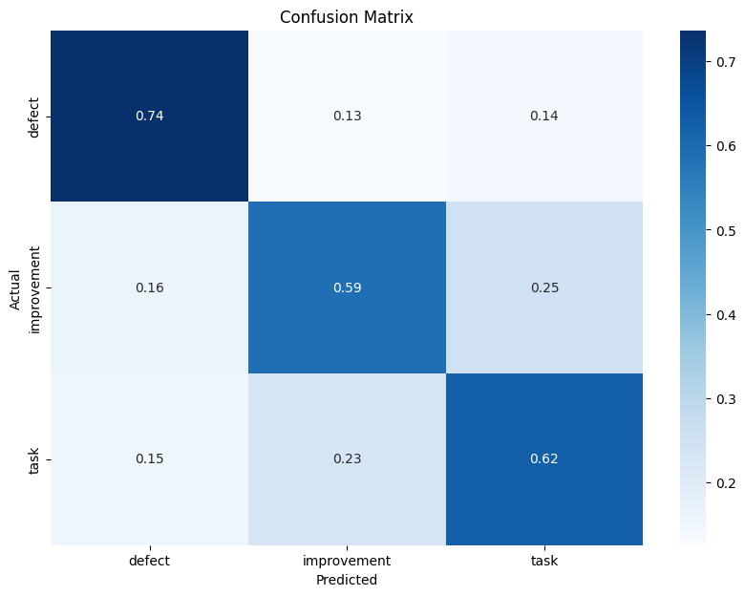
Results for Supervised Bugs Type Prediction
The created feature set have only been implemented with Multinomial Logistic Regression model, as of right now:
 | JIRA Dataset
Class | Precision | Recall | F1 - Score
defect | 0.86 | 0.74 | 0.79
improvement | 0.64 | 0.59 | 0.61
task | 0.32 | 0.62 | 0.42
ACCURACY | 0.68
The confusion matrix further the model's strength in predicting defects (with 0.74 recall), but also shows some confusion between predicting "improvement" and "task" bugs, where misclassification rates are relatively higher.

Slide 16
Timeline
Weeks starting from the data of submission for Mid Sem Progress Report.
Week 1: Finalize the preprocessing steps and enhance the existing pipeline to accommodate severity prediction for JIRA bugs.
Week 2: Evaluate the initial feature sets across various machine learning paradigms and document findings to identify areas for improvement.
Week 3: Develop a feature set for unsupervised bug type prediction and create a labeled testing set through manual labeling or using a language model.
Week 4: Assess the labeled testing set with different machine learning algorithms and analyze the results to refine predictions.
Week 5: Compile the results, create a comprehensive report detailing the findings, and prepare a presentation (PPT) to summarize the project outcomes and insights.

Slide 17
Contributions
Ishir Bhardwaj
Dataset finalization
Preprocessing steps determination
Pipeline establishment
Manit Kaushik
Designed the machine learning pipeline
Implemented feature engineering techniques
Conducted tests using Multinomial Logistic Regression
Analyzed results and provided insights
Pranav Gupta
Data cleaning and preparation
Implemented TF-IDF vectorization
Assisted in feature selection
Raghav Wadhwa
Conducted exploratory data analysis & literature review
Implemented evaluation metrics
Created presentation and report

Slide 18
FIN.

